Slide 1



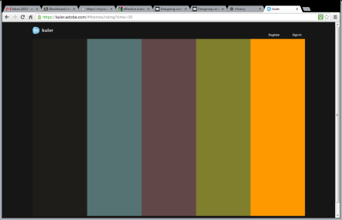


SERVICE-LEARNING COURSE (INCLUDE COURSE NUMBER AND TITLE)
COMMUNITY PARTNER (INCLUDE NAME AND LOCATION)
PROJECT TITLE, 72 pt or larger
Students names, affiliations | Students names, affiliations | Students names, affiliations
Professor(s)/Advisor(s) names, affiliations
INTRODUCTION/BACKGROUND 48 pt or larger
Why is this project important? Who does it impact? How did this project come about? When did the project start? What is the motivation? Mention key statistics, such as the number of people or places this work could impact (or provide an info-graphic to illustrate them), and include references. Place your reference citations in the reference section below.
Keep body text brief and concise. 28 pt or larger font.
METHODOLOGY
Describe how you went about addressing the challenge. Explain your approach using bullets, numbers, or step by step instructions. Which community partners did you work with? Who were the participants? What activities did you engage in? How did you apply what you learned in class to achieve your objectives?
IMPACTS
Describe the impacts of the service-learning project. Include quantifiable amounts, e.g., numbers of people impacted, number of kW generated, gallons of water produced, impacts on the community, what did you learn from the project, etc.
Make it your own!
This is a template. Move things around. Get creative with graphics. Consider the fields provided as a guide to what you should include, but don’t feel too constrained by it.
Graphics
Two to four high-resolution photos – Preferably of “service-learning in action”. Include photo reference information such as the photographer, date, and place taken. If you are not using original photographs, please provide a reference/link to the original work.
Three figures and/or info-graphics – e.g., renderings, schematics, graphs. If you are not using original figures or graphics, please provide a reference to the original work.
Colors
Why use the same old MS color palates? Find creative palates to match the spirit of your work here: https://kuler.adobe.com
Once you find one you like, in PowerPoint you can go to the Design tab, choose Colors, select Create New Theme Colors, and manually match the colors from your selected palate.
NOTE: Colored backgrounds do not print well and use a lot of ink. Accent with color, but don’t drown your poster in it.
Include a title, or an explanation of what’s relevant about the figure. Reference any data sources.
Poster dimensions
This template is 48-in wide by 36-in tall.
You may use a portrait or landscape poster, but its dimensions must not exceed 48” by 36”.
To change the dimensions of this poster, go to Design, Customize, Slide Size, Custom Slide Size, and enter the dimensions you prefer.
IMPACTS
Describe the impacts of the service-learning project. Include quantifiable amounts, e.g., numbers of people impacted, number of kW generated, gallons of water produced, impacts on the community, what did you learn from the project, etc.
Source: Who took the photo, when?
Source: Who took the photo, when?
Source: Who took the photo, when?
REFLECTION & CONCLUSION
What challenges did you face while doing your project? How did you overcome the challenges? If you were to do this again what would you do differently?
Describe future plans for the project. Offer recommendations to future students working on the project.
Great resources for inspiration!
A blog about designing research posters: http://colinpurrington.com/tips/academic/posterdesign
Flickr group “Pimp My Poster”: http://www.flickr.com/groups/pimpmyposter/
OBJECTIVES 48 pt or larger
What is the purpose or goal of the project? 28 pt or larger font.
Provide in list or bullet form
Provide in list or bullet form
Provide in list or bullet form
Source: Who took the photo, when?
Include a title, or an explanation of what’s relevant about the figure. Reference any data sources.
REFERENCES
[1] Use any citation style
[2] Chicago, MLA, APA, etc.
[3] Just be consistent
ACKNOWLEDGMENTS
Acknowledge those supported your work. Example (advisor, fellow classmates, community partners, grant funding agency/program)

